Slide 1
Problem Solving

Slide 2
Problem Solving
What is problem
Problems are at the center of what many people do at work every day.
A matter or situation regarded as uwelcome / harmful and need to be dealt with overcome is known as problem.
Computer / Microprocessor is the main device nowadays for finding the solution of a problem ,because of it’s speed and the way it can deal with data.
Generally problems are solved using some sort of program/software using any computer programming language.

Slide 3

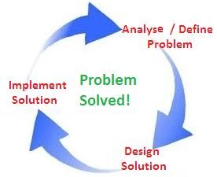
Problem Solving
Cycle
There are 3 basic steps for solving any problem using computer/computer program
Analyse / Define problem
Design Solution (developing an algorithm, coding, testing and debugging)
Implement solution
Which can be further extended in larger domain.

Slide 4
Problem Solving
Cycle
1. Analyse / Define problem
In almost every methodology the first step is defining or identifying the problem. It is the most difficult and the most important of all the steps. It involves diagnosing the situation so that the focus on the real problem and not on its symptoms.
For example, ‘if performance in any department is substandard, we might think the problem is with the individuals submitting work. However, if we look a bit deeper, the real issue might be a lack of training, or an unreasonable workload’.
As above example, same thing may happen with problem solving
using computer program, So before starting designing/coding
,problem must be thoroughly defined/ analysed.

Slide 5
Problem Solving
Cycle
1. Analyse / Define problem
The process of understanding the defining it on the basis of following:
problem and then
Data requirement of the given problem
Type of input variable required
Type of output variable required is definition
called
problem

Slide 6
Problem Solving
Cycle
1. Analyse / Define problem
Suppose we are assigned to solve an arithmetic problem and we are not familiar with steps involved in solving that problem. In Such a case,we will not be able to solve the problem. The same applied to writing computer programs. A computer programmer cannot write the instructions to be followed by the computer unless he knows how to solve that problem. The first step in application development is problem definition. In addition, a program souce data, logical and practical procedures needed to solve the problem. This analysis must taken placed before actual preparation of program development, otherwise it will cause much cost and time.

Slide 7
Problem Solving
Cycle
2. Design Solution Design is a process to transform user requirements into some suitable form, which helps the programmer in software coding and implementation.
Programming tools, program design tools are the tools used to
develop a program. following are some of them
Algorithm
Flowchart
Pseudo-code

Slide 8
Problem Solving
Cycle
2. Design Solution Designing an algorithm:
An algorithm is a plan, a logical step-by-step process for solving a problem. Algorithms are normally written as a flowchart or in pseudo-code as it’s next level.
When designing an algorithm there are two main areas to look at:
the big picture - What is the final goal?
the individual stages – What hurdles need to be overcome on the
way to the goal?

Slide 9
Problem Solving
Cycle
2. Design Solution
An algorithm to Find largest of two numbers
Step 1: Start
Step 2: Declare variables a,b
Step 3: Read variables a,b
Step 4: If a>b
If a>b
Display a is the largest number.
Else
Display b is the largest number.

Slide 10



Problem Solving
A flowchart is simply a graphical representation of steps. It shows steps in a sequential order, and is widely used in presenting flow of algorithms, workflow or processes. Typically, flowchart shows the steps as boxes of various kinds, and their order by connecting them with arrows.
Flowchart Symbols
Different flowchart shapes have different conventional meanings. The meanings of some of the more common shapes are as follows:
Terminator
The terminator symbol represents the starting or ending point of the system.
Process
A box indicates some particular operation.
Document
This represents a printout, such as a document or a report.

Slide 11



Problem Solving
Decision
A diamond represents a decision or branching point. Lines coming out from the diamond indicates different possible situations, leading to different sub-processes.
Data
It represents information entering or leaving the system. An input might be an order from a customer. An output can be a product to be delivered.
Flow
Lines represent flow of the sequence and direction of a process.

Slide 12

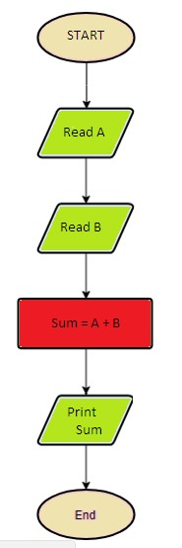
Problem Solving
Representation of algorithm using flowchart
E.g. Flowchart for addition of two numbers

Slide 13

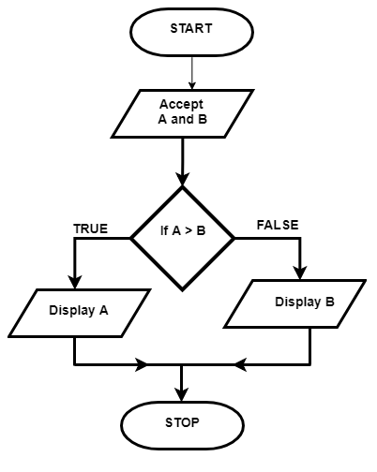
Problem Solving
Representation of algorithm using flowchart Example- Flowchart for finding largest of two numbers

Slide 14
Problem Solving
Pseudo-code
Pseudocode is not a programming language, it is a simple way of describing a set of instructions that does not have to use specific syntax.
There is no strict set of standard notations for pseudocode, but some of the most widely recognised are:
INPUT/READ – indicates a user will be inputting something
OUTPUT/WRITE – indicates that an output will appear on the screen
WHILE – a loop (iteration that has a condition at the beginning)
FOR – a counting loop (iteration)
REPEAT – UNTIL – a loop (iteration) that has a condition at the end
IF – THEN – ELSE – a decision (selection) in which a choice is made
any instructions that occur inside a selection or iteration are usually indented

Slide 15
Problem Solving
Representation of algorithm using Pseudo-code
Example- Pseudocode to find out largest of two numbers
Write "please enter 2 numbers" Read n1,n2
If(n1 > n2)
Set max to n1 Else
Set max to n2

Slide 16
Problem Solving
Difference between algorithm and pseudo-code
An algorithm is a well defined sequence of steps that provides a solution for a given problem, while a pseudocode is one of the methods that can be used to represent an algorithm.
While algorithms can be written in natural language, pseudocode is written in a format that is closely related to high level programming language structures.
Pseudocode does not use specific programming language syntax and therefore could be understood by programmers who are familiar with different programming language.Transforming an algorithm presented in pseudocode to programming code could be much easier than converting an algorithm written in natural language.

Slide 17
Problem Solving
Coding :
Coding is basically implementing logic/algorithm/pseudocode (derived from requirement analysis/problem definition) in one of the preferred programming language(C,C++, Java, Javascript, python etc) as per the protocols/rules/ syntactic grammar of the chosen language by following the design decisions.

Slide 18
Problem Solving
Testing :
Software Testing is a method to check whether the actual software product matches expected requirements and to ensure that software product is Defect free.
Testing is Important because if there are any bugs or errors in the software, it can be identified early and can be solved before delivery of the software product. Properly tested software product ensures reliability, security and high performance which further results in time saving, cost effectiveness and customer satisfaction

Slide 19
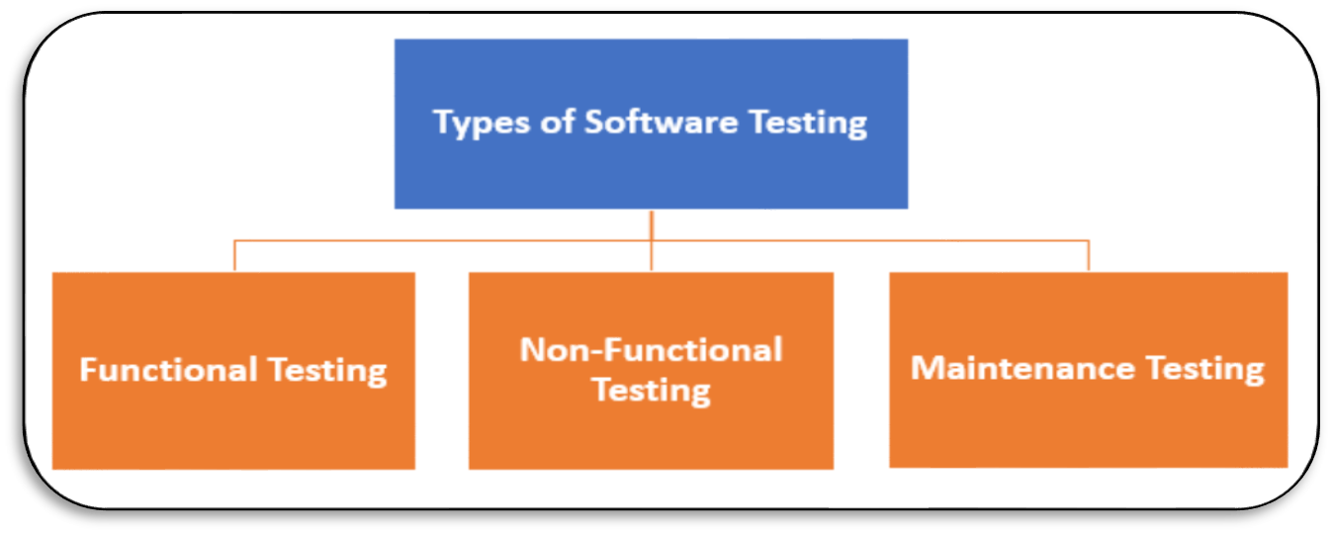
Problem Solving
Types of Software Testing
Functional Testing
Non-Functional Testing or Performance Testing
Maintenance (Regression and Maintenance)

Slide 20

Problem Solving
Types of Software Testing
Testing | Types of Testing
Functional Testing | Unit Testing - individual units or components of a software are tested Integration Testing –components are combined and tested as a group Smoke - determines whether the employed build is stable or not UAT ( User Acceptance Testing) - actual users test the software as was required Localization- behavior of a software is tested for a specific region,locale ,culture Globalization - ensure that the software application can work in any locale
Non- Functional Testing | Performance - for testing the speed, response time, stability,reliability, scalability Endurance - testing a system with a significant load given over a time Load - software application is tested under a specific expected load Volume - to check the data volume handled by software Scalability - ability to scale up or scale down the number of user requests Usability - how easy and user-friendly a software application is
Maintenance | Regression - testing existing software applications to make sure that a change or addition hasn't broken any existing functionality Maintenance - Testing done during this enhancement, change and migration cycle is known as maintenance testing

Slide 21
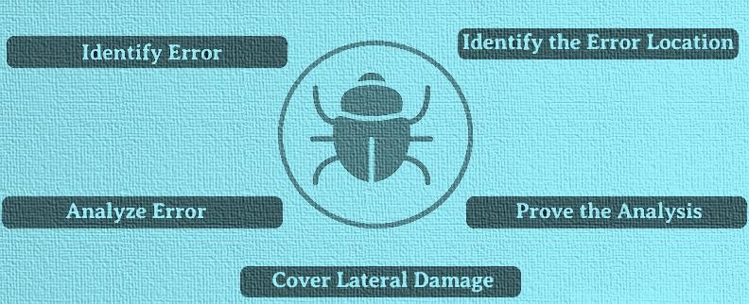
Problem Solving
Debugging
Software programs goes through testing, updating,
troubleshooting, and
maintenance during the development
process. Usually, software contains errors and bugs, which are removed routinely. Debugging is the process of fixing a bug in the software.
Debugging Steps ->

Slide 22
Problem Solving
3. Implementation
Implementation refers to the process of adopting and integrating a software application into a real environment.Implementation of new tools and software into an enterprise can be complex, depending on the size of the organization and the software.
Implementation Methods
Parallel- When the new system is used at the same time as the old system the two systems are said to be running in parallel.
Phased-When small parts of the new system gradually replace small parts of the old system, the implementation method is said to be phased.
Pilot-When a small group of users within an organization uses a new system prior to wider use, the system is said to be piloted.
Direct-When a new system is implemented without any phased or pilot implementation

Slide 23
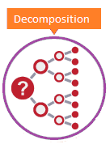
Problem Solving
Decomposition
Decomposition also known as factoring, is breaking a complex problem or system into parts that are easier to conceive, understand, program, and maintain.
Need for decomposing a problem
It involves breaking down a complex problem or system into smaller parts that are more manageable and easier to understand. The smaller parts can then be examined and solved, or designed individually, as they are simpler to work with.

Slide 24
Problem Solving
Example of Decomposition
1. Banking Transaction System
BANKING
ACCOUNT
CREATION
DEPOSIT
MONEY
WITHDRA W MONEY
Note : It can be further decomposed to next level as per need

Slide 25
Problem Solving
Example of Decomposition
2. LIBRARY MANAGEMENT SYSTEM
LIBRARY ACTIVITY
ENTRY OF
BOOK
MEMBER ENTRY
ISSUE BOOK
DEPOSIT BOOK
Note : It can be further decomposed to next level as per need

Slide 26
Problem Solving
Example of Decomposition
3. PAYROLL SYSTEM
PAYROLL
EMPLOYEE
ENTRY
WORK HOUR/DAY S ENTRY
PAY SALARY/TRANSF ER MONEY INTO EMPLOYEE ACCOUNT
PAYSLIP GENERATIO N
Note : It can be further decomposed to next level as per need

